Slide 1

Exploratory Data Analysis of Unicorn Companies

Slide 2
Data Cleaning & Manipulation
1,074 companies analysed
Missing values in City, Select Investors and Funding columns cleaned
Funding and Valuation columns converted to numeric
Artificial intelligence industry values unified
Annualised ROI used for realistic analysis after creating columns
Select Investors column exploded to analyse investors

Slide 3
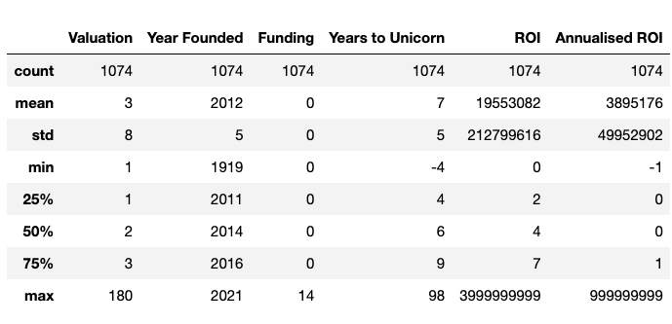
FINDINGS
The average unicorn valuation is approximately $3 billion.
The average time for a company to become a unicorn is around 7 years.
Yidian Zixun reached unicorn status 4 years prior to its founding, reasons unknown.
Majority of unicorn companies began in 2012.

Slide 4
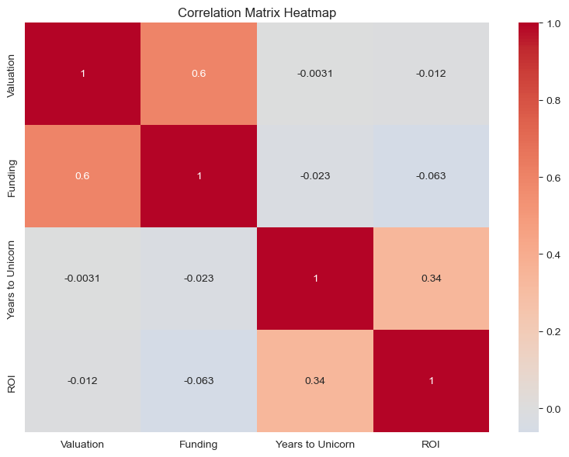
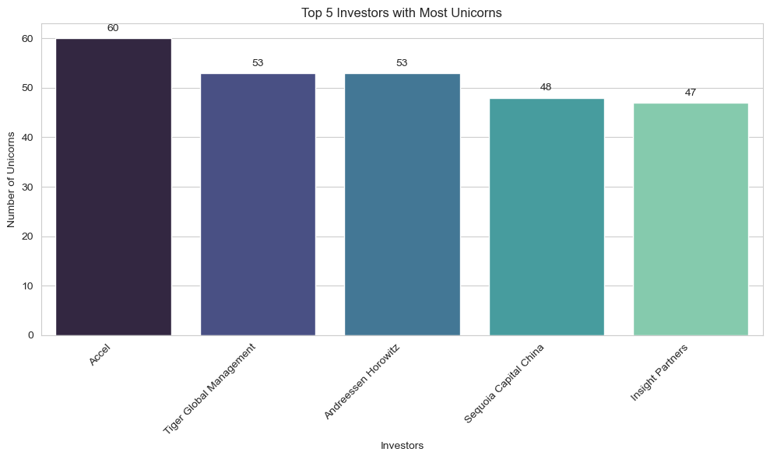
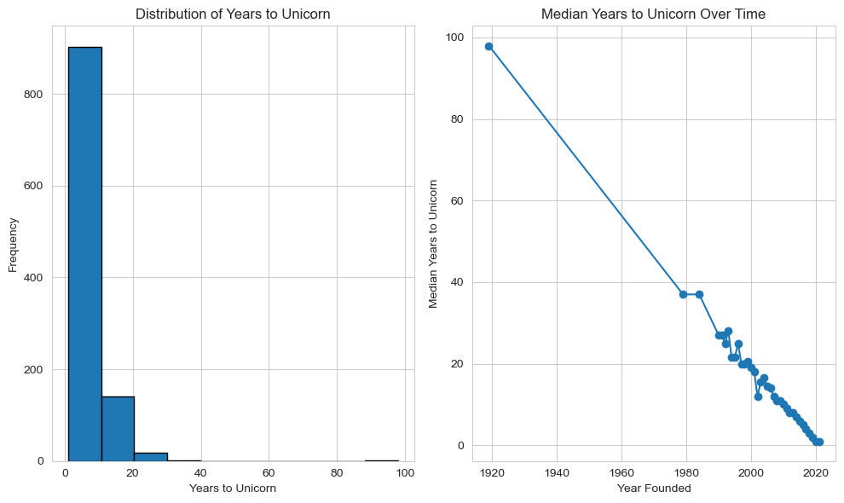
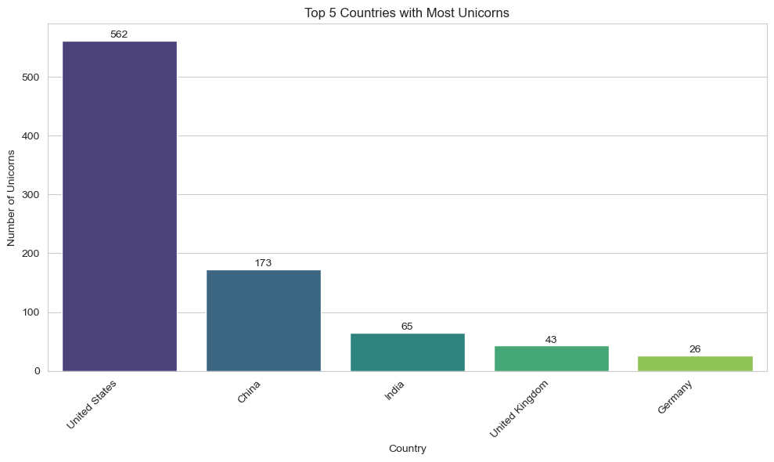
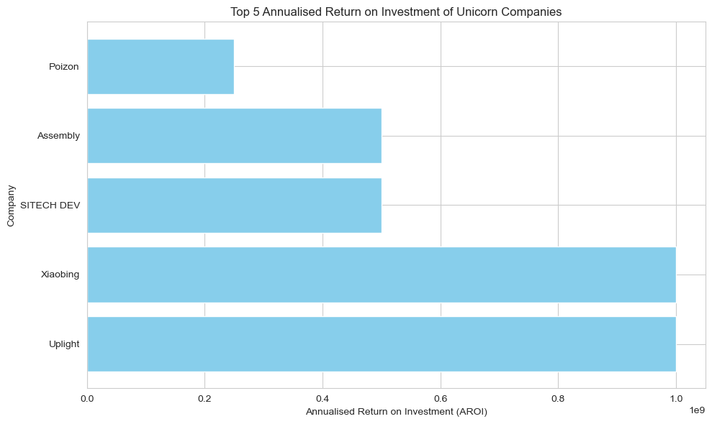
INSIGHTS
Fintech industry: 224 unicorns (highest), Travel industry: 14 unicorns (lowest), IT sector dominates top 4 industries.
USA: Highest unicorns (562), top cities: San Francisco and New York (562 total).
China: 173 unicorns, top cities: Beijing and Shanghai (China).
San Francisco: Industrial hub with high ROI potential.
ROI analysis: Top ROI - Otto Bock HealthCare, SSENSE (4B), Uplight, RSN (2B), Sitech Dev (1B).
Annual ROI analysis: Uplight, Xiaobing (1B), Sitech Dev, Assembly (500M), Poizon (250M).
Most unicorns took 0-10 years to emerge (900+ out of 1074).
Trend: Decline from 98 years to <1 year to become unicorn.
Funding vs. Valuation: Higher funding correlates with higher valuation.
Industry valuations: AI (180B), Consumer Retail (40B), Mobile Telecom (1B).
Funding: Consumer Retail (14B), Mobile Telecom (1B), AI (8B).
Valuation: AI (180B), Cybersecurity (low), Mobile Telecom (low).
Strong correlation: Valuation and Funding, ROI and Years to Unicorn.
Positive relation: Years to Unicorn and ROI.
Negative relation: ROI, Valuation, Funding, Years to Unicorn.
Top investors: Accel, Tiger Global (60, 53), Andreessen, Sequoia (53, 48), Insight (47).
Fintech industry: 645 investors (highest), Travel industry: 40 investors (lowest), IT sector leads in investor count.

Slide 5
Recommendations
Recommendations for Investors:
Diversify Investments: Explore opportunities beyond the Fintech industry to tap into potential growth in other sectors.
Strategic Partnerships: Collaborate with top unicorn companies in San Francisco to maximise ROI.
Global Market: Consider investing in Chinese markets with a significant number of unicorns, especially in Beijing and Shanghai.
Long-Term Strategy: Focus on companies with longer time-to-unicorn, as they tend to exhibit higher ROI over time.
Tech Innovation: Embrace investments in AI-driven companies for substantial valuation potential.
Recommendations for Unicorn Companies:
Industry Analysis: Focus on sectors like Fintech and IT, where unicorn growth is prominent.
Global Expansion: Consider entering or expanding in the USA, particularly San Francisco and New York, for investor interest.
Strategic Partnerships: Attract leading investors like Accel, Tiger Global, and Andreessen for growth acceleration.
Efficient Funding: Seek investments that align with valuation goals, especially in AI and Consumer Retail industries.
Agile Approach: Strive for quicker time-to-unicorn to optimize ROI, while maintaining sustainable growth.

